Slide 1
Urine Tract Infections in children
Bashir Admani
Consultant Paediatrician /Paediatric Nephrologist

Slide 2
What is a Urine Tract Infection??
Urine tract infection is colonisation by bacteria in any part of the urinary tract
It is a common bacterial infection in children
Associated with high morbidity

Slide 3
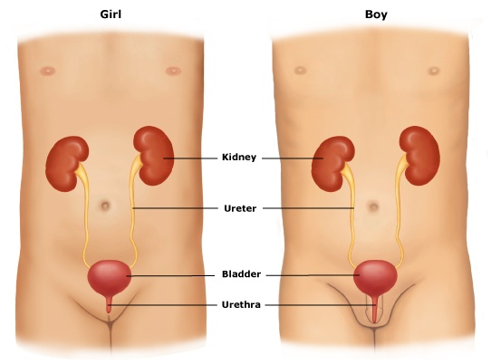
Urine tract

Slide 4
WHY DO WE NEED TO DISCUSS URINE TRACT INFECTIONS IN CHILDREN????

Slide 5
Important
UTI in children is quite common
The infection can affect the kidneys and if not diagnosed or treated early can cause permanent damage to the kidneys leading to chronic kidney disease and hypertension

Slide 6
Significance of UTI
permanent renal scarring
life long risk of hypertension due to renal scarring
life long risk of end-stage renal failure
recurrence of problems during pregnancy

Slide 7
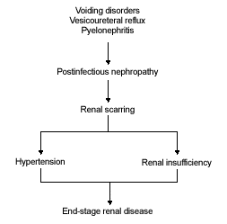
Background
Complications (Upper UTI)
Acute renal injury
  50-60% of children shortly after diagnosis of upper UTI
Renal scarring
  10-15% of children with UTI
  Children <1year at much greater risk
  Children >5y rarely have new renal scarring with UTI
Endpoint
    Hypertension
    Renal insufficiency
    Renal failure
Benador D; Benador N; Slossman D et al. Are younger children at highest risk of renal sequelae after pyelonephritis? Lancet 349(9044): 17-19, 1997
Notes:
Because of these potential sequelae it is important that UTIs are diagnosed promptly and accurately
In 50-60% of affected children the inflammation produces irreversible lesions of the renal parenchyma. The damaged areas of renal tissue are replaced by fibrous scars and the damage can subsequently lead to arterial hypertention and renal failure
Several studies report that the susceptibility of the kidney to renal parenchyma to infection varies with age with infants under 1 at greater risk than those over 5yrs. First, the UTI may bring to attention a child with an obstructive anomaly or severe VUR. Second, because infants and young children with UTI may have a febrile illness and no localizing findings, there may be a delay in diagnosis and treatment of the UTI. Clinical and experimental data support the concept that delay in instituting appropriate treatment of acute pyelonephritis increases the risk of kidney damage.14,15 Third, the risk of renal damage increases as the number of recurrences increases16
Controversy continues regarding the association of vesicoureteral reflux with the pathogenesis of renal scarring, reflux nephropathy, pyelonephritis and voiding disorders. Although vesicoureteral reflux is associated with renal scarring,7 its role in the pathogenesis of pyelonephritis and renal scarring is not fully understood.8 Findings from one study9 showed that scars formed in 40 percent of refluxing kidneys and 43 percent of nonrefluxing kidneys. While some researchers emphasize the risk of renal scarring from recurrent UTI without reflux,10 others are just as adamant regarding the risk of scarring from reflux in the absence of infection.11 The fact that renal scarring develops in only a minority of patients with pyelonephritis and/or vesicoureteral reflux suggests that the development of renal scarring likely involves the interplay of several factors and cannot simply be attributed to the presence of infection or reflux alone

Slide 8

but a small minority will
The vast bulk of children with urinary tract
infections will suffer no serious sequelae

Slide 9
Background
Epidemiology
  Incidence
    All newborns 0.1-1% (LBW newborns up to 10%)
    Under 6 months
    Preschool: greater in females
    School age: 30-fold greater in females
  Prevalence
 | Females | Males
< 1yr | 7% | 3%
> 1yr | 8% | 2%
Overall < 21yr | 9 – 15%
Hoberman A, Chao HP, Keller DM et al. Prevalence of Urinary tract infection in febrile infants. J Pediatrics, 123(1): 17-23, 1993
AAP: Practice Parameter; The diagnosis, treatment and evaluation of the initial urinary tract infection in febrile infants and young children. Pediatrics, 103(Pt 1): 843-52, 1999
Notes:
The under 1yr and over 1yr data in downs report: technical report urinary tract infections in febrile infants and young children: the urinary tract subcommittee of the american academy of pediatrics committee on quality improvement.

Slide 10
Background
Classification*
    Asymptomatic bacteruria
    Cystitis (Lower UTI)
    Pyelonephritis (Upper UTI/Complicated cystitis)
Route of Infection
    Hematogenous spread (neonates)
    Ascension of bacteria migrating from GI tract (beyond infancy)
Pathogens
Gr – Bacilli (90%) | Gr - Cocci | Gr + Cocci (5%) | Fungi | Viruses | Parasites | Other
E. Coli (80%) Klebsiella Enterobacter Citrobacter Proteus Pseudomonas Morganella Providencia Serratia | Neisseria | Enterococcus Staphylocccus Streptococcus | Candida Trichosporon Microsporidia | Adenovirus Polyomavirus HSV | Schistosoma | Chlamydia Mycobacteria
*in children < 2yrs, difficult to distinguish between upper and lower UTI
Notes:
In the normal host most uropathogens orignate in the gastrointestinal tract, migrate to the periurethral area and the urethra; and ascend to the bladder where they stimulate a host response. Bacterial adhesins (pili) and other virulence factors; such as hemolysin and flagellae are important in the pathogenesis of acute cystitis in that they offer selective advantage to the bacteria that possess them.
The presence of these virulence factors coupled with the propensity to adhere to the female periurethral mucosa may explain the increased incidence of acute cystitis in females compared to males.
Other factors that contribute to lower incidence in males include the antibacterial properties of prostatic fluid and the drier periurethral environment and longer urethra in males compared to females.
E. Coli and other gram negative organisms account for nearly 90% of cases of uncomplicated cystitis in older children; adolescents; and young adults. Enteric pathogens that have become increasingly prevalent causes of acute cystitis include klebsiella, enterobacter; and pseudomonas. Most childern in whom these pathogens are isolated have underlying conditions or comorbidities
Immunocompromised children; those with indwelling urinary catheters; and those with anatomical or physiological abnormalities are more likely to have infection with resistant organisms, fungal pathogens or even ubiquitous viruses.
E. Coli accounts for 80% of UTIs in children. Approximately 50% of E. Coli resistant to amoxil or ampicillin. Increasing rates of resistance with first generations cephalosporins. Second and third generation cephalosporins are appropriate first line drugs but should not be used if enterococcus suspected, in those with catheters, instrumentation or anatomical abnormality. In such cases amoxil or ampicillin should be added.
Prevalence of asymptomatic bacteriuria 0.7 – 1.6%

Slide 11
Background
Predisposing factors
  Obstructive uropathy (e.g. Posterior urethral valves)
  Vesicourethral reflux (VUR)
  Voiding disorders
  Renal calculi
AAP: Practice Parameter; The diagnosis, treatment and evaluation of the initial urinary tract infection in febrile infants and young children. Pediatrics, 103(Pt 1): 843-52, 1999
Notes:
The rate of VUR among children younger than 1 year of age with UTI exceeds 50%
The grading of VUR is important because the natural history differs by grade, as does the risk of renal damage. Patients with high-grade VUR are 4 to 6 times more likely to have scarring than those with low-grade VUR and 8 to 10 times more likely than those without VUR.16,49
Incidence of VUR 1%. Children tested for VUR in one of two clinical situations
During assesssment of prenatally diagnosed hydronephrosis and
- the evaluation of UTI
Reflux diagnosed in about 10% of cases of prenatally identified hydronephrosis. It is often high-grade and occurs more frequently in boys than in girls. Incidence of reflux in girls is evaluated after the first UTI and is bewzeen 25-40%.
An increased incidence in families suggests a genetic component
Natural history is spontaneous resolution to occur over time a longer time being necessary in the more severe forms
Average figures are 80-86% for grade II, and 40-46% grade III over 5 years
In study done by Skoog and associates spontaneous resolution occured in 1.65 yrs in grade II
1.97 years for grade III

Slide 12
Background
Risk Factors
  Male
    Uncircumcised <1yr (4-10 times greater risk than in the circumcised)
    All less than 6 months
  Family history of VUR or renal disease
  Constipation
  Evidence of spinal lesions
  History suggestive of previous UTI or confirmed previous UTI
  Recurrent fever of uncertain origin
  Immunodeficiency
  Sexual activity (particularly in females)
Zorc J, Levine D, Platt S, et al. Clinical and demographic factors associated with urinary tract infection in young febrile infants. Pediatrics 116(3): 644-46, 2005
National Collaborating Centre for Women’s and Children’s Health: Urinary tract infection in children: diagnosis, treatment and long-term management. National Institute for Health and Clinical Excellence, 2007
AAP: Practice Parameter; The diagnosis, treatment and evaluation of the initial urinary tract infection in febrile infants and young children. Pediatrics, 103(Pt 1): 843-52, 1999
Craig J, Knight J, Sureshkumar P, et al. Effect of circumcision on incidence of urinary tract infection in preschool boys. J Pediatrics. 128(1): 23-7, 1996
Notes:
VUR can be secondary ie associated with anatomical obstruction to bladder outflow, but more often it is a primary lesion associated with failure of anti-reflux mechanisms at the ureteral-vesical junction
Patients with urodynamic dysfunction; neurogenic bladder; or incomplete bladder emptying may harbour pathogens in residual urine thereby creating a source of recurrent infection
Reflux nephropathy describes renal parenchymal disease associated with VUR
Radiology tests to detect VUR rather than renal parenchymal disease are often instigated in children with UTI because of the triad of UTI/VUR/Nephropathy.
Primate experiments demonstrate that renal parenchymal damage can occur following introduction of E. Coli into the bladder without VUR. These lab results support anecdotal observations that renal parenchymal damage can be acquired in children after a UTI despite failure to detect VUR:
The incidence of vesicoureteral reflux (VUR) is higher in this age group than in older children (Fig 1), and the severity of VUR is greater, with the most severe form (with intrarenal reflux or pyelotubular backflow) virtually limited to infants.
Sexually active young females have approximatelyy 0.5 episodes of acute cystitis per person year

Slide 13
Background
Urinary Tract Infection (UTI)
Presumptive UTI
Presence of bacteria in the urine
Plus
Symptoms
Definitive UTI
Positive urine culture
Plus
Symptoms

Slide 14
Clinical features
Signs depend on the age of the child
In older children:
  Painful micturition
  Frequency
  Urgency
  Pain in the back or flanks
  Lower abdominal pain
  Fever > 38

Slide 15
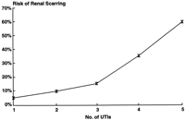
Management of UTI
Infants and children warrant special attention
  Have febrile illness with no localizing features
  Obstructive anomalies
  Vesicoureteric reflux
    Higher incidence in this group
    Greater severity in this group
  Prevent renal damage
    Recurrent UTI increase risk of renal damage
AAP: Practice Parameter; The diagnosis, treatment and evaluation of the initial urinary tract infection in febrile infants and young children. Pediatrics, 103(Pt 1): 843-52, 1999

Slide 16
Suspecting a UTI
Non-specific clinical findings particularly in infants and children less than 3 years
AGE GROUP |  | SYMPTOMS AND SIGNS Most common Least common
Infants younger than 3 months |  | Fever Vomiting Lethargy Irritability | Poor feeding Failure to thrive | Abdominal pain Jaundice Hematuria Offensive urine
Infants & children 3 months or older | Preverbal | Fever | Abdominal pain Loin tenderness Vomiting Poor feeding | Lethargy Irritability Hematuria Offensive urine Failure to thrive
 | Verbal | Frequency Dysuria | Dysfunctional voiding Changes to continence Abdominal pain Loin tenderness | Fever Malaise Vomiting Hematuria Offensive urine Cloudy urine
National Collaborating Centre for Women’s and Children’s Health: Urinary tract infection in children: diagnosis, treatment and long-term management. National Institute for Health and Clinical Excellence, 2007
Notes:
Clincal findings in children often subtle and non-specific with fever often the only finding. Identification of low risk children desirable to reduce costs of unnecessary urine culture;but identification of those with a high likelihood of UTI to begin presumptive treatment while waiting for the results of the urine culture
The likelihood that UTI is the cause of the fever may be increased if there is a history of crying on urination or of foul-smelling urine. An altered voiding pattern may be recognized as a symptom of UTI as early as the second year after birth in some children. Dysuria, urgency, frequency, or hesitancy may be present but are difficult to discern in this age group. Nonspecific signs and symptoms, such as irritability, vomiting, diarrhea, and failure to thrive, also may reflect the presence of UTI, but data are not available to assess the sensitivity, specificity, and predictive value of these clinical manifestations.

Slide 17
Clinical features
Younger children the signs are a little ambiguous
  Fever may be the only symptom
  Vomiting
  Abdominal pains
  Foul smelling urine
  Irritability
  Poor feeding
So it is important to have a high index of suspicion in children

Slide 18
Suspecting a UTI
High index of suspicion in a febrile child will lessen the number of UTIs missed
  Urinalysis recommended in all febrile children without a focus of infection (prevalence 5%)
Study in KNH on febrile children had prevalence of about 10%
AAP: Practice Parameter; The diagnosis, treatment and evaluation of the initial urinary tract infection in febrile infants and young children. Pediatrics, 103(Pt 1): 843-52, 1999
Notes:
Current canadian pediatric society guidelines recommend that for the evaluation of a toxic appearing child less than 3yrs of age with fever less than 39 rectal or 38.5 oral, without a focus, urinalysis and urine culture should be obtained.
The concept that otherwise unexplained fever in a child with UTI indicates that renal parenchymal involvement is based on comparison of children with high fever (39°C) and the clinical diagnosis of acute pyelonephritis with those with no fever (38°C) and a clinical diagnosis of cystitis

Slide 19
Diagnosis
Diagnosis of UTI requires culture of an appropriately collected urine sample

Slide 20
Diagnosis
Method of collection of urine
  Urine specimen should be obtained by suprapubic aspiration (SPA) or transurethral catheterization. Diagnosis of UTI cannot be established by culture from a sample collected in a bag
    Specificity of urine bag: 70%
    Specificity of catheter sample: 85-89%
    Specificity of SPA: 99%
Rapid screening tests
    Dipstick biochemical analysis for nitrites or leukocyte esterase (LE)
    Microscopic examination of urine for formed elements including white blood cells or bacteria
AAP: Practice Parameter; The diagnosis, treatment and evaluation of the initial urinary tract infection in febrile infants and young children. Pediatrics, 103(Pt 1): 843-52, 1999
Notes:
Due to the high contamination rates (50%) and the less favourable risk profile, the AAP concluded that bag specimens are not useful for diagnosing a UTI and should always be followed by another method to confirm the diagnosis
Urine obtained from a bag is useful for dipstick and microscopic evaluation.
A negative urine culture is highly specific for ruling out UTI
An diagnosis of UTI that is made with a bag urine specimen in a young infant requires confirmation with another method (SPA or urethral catheterization)
In a setting of acute sepsis or suspected sepsis where empirical antibiotics are to be instituted on an urgent basis, screening bag urine specimens is not recommended because confirmatory specimens would be affected by the empirical antibiotics
All urine specimens should be transported to the processing lab for culture as quickly as possible after voiding
Either SPA or transurethral bladder catheterization should be used to establish the diagnosis of UTI. Cultures of urine specimens collected in a bag applied to the perineum have an unacceptably high false-positive rate; the combination of a 5% prevalence of UTI and a high rate of false-positive results (specificity, ~70%) results in a positive culture of urine collected in a bag to be a false-positive result 85% of the time.

Slide 21
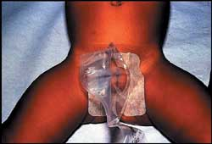
Bag specimen
Clean genitalia with clean water
Remove immediately after micturition
Unacceptable for culture -only good for screening sensitivity good poor specificity 70%
If positive (dipstix leuc or nitrite) then send another specimen using other collection method

Slide 22
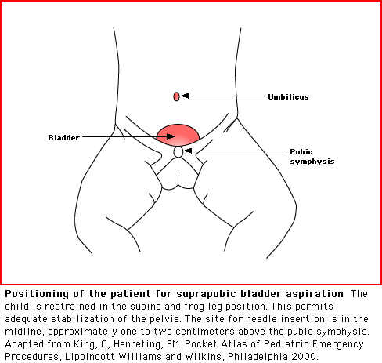
Suprapubic Puncture

Slide 23
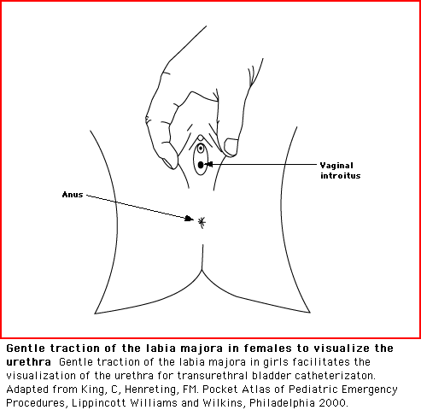
‘In and out catheter’:girl

Slide 24
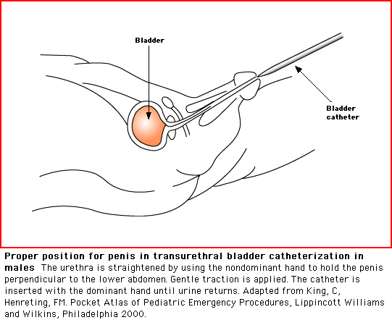
‘In +out catheter’:boy

Slide 25
Diagnosis
Urinalysis cannot substitute for a urine culture in the diagnosis of a UTI but can be valuable in selecting individuals for initiation of prompt treatment while awaiting culture results.
AAP: Practice Parameter; The diagnosis, treatment and evaluation of the initial urinary tract infection in febrile infants and young children. Pediatrics, 103(Pt 1): 843-52, 1999
Notes:
Gorelick meta-analysis 26 studies met inclusion criteria.
In a meta-analysis the goal is to combine results from different studies to obtain a more precise estimate than is possible. The simlest means of combining results is to pool raw data from all included studies yielding a weighted average for true positive and false postive rates. Important methdological consideration is whether differences in results among studies of a given test are deemed to represent simply random differences or whether such differences represent underlying heterogeneity in the studies. Thus for each diagnostic test of interest; separate comparisons of the TPRs and FPRs of all studies were performed using pearson chi test.
For predicting a postive urine culture; the presence of any bacteria on a gram-stained specimen offers the best combination of sensitivity and specificity
Dipstick performs nearly as well with slightly lower sensitivity for the presence of any nitrite or LE and a slightly better FPR for the presence of both LE and nitrite. The technically more demanding microscopic analysis offers no advantage over dipstick test or gram stain. The enhanced urinalysis, a combination of gram stain and cell count performed in a counting chamber using an uncetrifuged urine specimen; also seels to provide an excellent combination of sensitivity and specificity

Slide 26
Diagnosis
Predicting a positive urine culture
  Dipstick has low sensitivity for the presence of nitrite (72%) but LE (85%) (specificity of nitrate - 96%)
  Presence of pyuria of 5 WBCs/hpf (25 WBCs/mm³) in the standard centrifuged urine sample, has poor sensitivity (67%) (cannot be recommended for presumptive diagnosis of UTI)
  In an enhanced urinalysis (uncentrifuged urine sample) pyuria of 10 WBCs/mm³ is considered positive. This definition of significant pyuria is more sensitive (77% all ages, 90% <2yrs)
  Presence of bacteria (uncentrifuged) plus pyuria offers the best combination of sensitivity and specificity (93% & 95% respectively) for predicting UTI
Gorelick, MH and Shaw KN. Screening tests for urinary tract infection in children: A meta-analysis. Pediatrics, 104(5):e45, 1999

Slide 27
Diagnosis
Sensitivity of a positive LE or identification of WBCs microscopically individually is also low (84% & 50% respectively)
  High risk of missing a UTI by either test alone
Nitrite test has a very high specificity (98%). Specificity of LE is 78%.
  When nitrite
    Positive, high likelihood of UTI
    Negative, little value ruling out UTI
 | Positive LR
Nitrite | 25
Leukocyte esterase (LE) | 5
Nitrite and LE | 18
Microscopy, bacteria (C) | 5
Microscopy, bacteria (UC) | 19
Microscopy, leukocytes (C) | 4
Microscopy, leukocytes (UC) | 7
LR values > 10: test 10 times more likely to be present in a child with a UTI than one without
Gorelick, MH and Shaw KN. Screening tests for urinary tract infection in children: A meta-analysis. Pediatrics, 104(5):e45, 1999
AAP: Practice Parameter; The diagnosis, treatment and evaluation of the initial urinary tract infection in febrile infants and young children. Pediatrics, 103(Pt 1): 843-52, 1999
UTI Guideline Team, Cincinnati Children’s Hospital Medical Center: Evidence-based care guideline for medical management of first urinary tract infection in children 12 years or less, Guideline 7 (1-23), 2006
Notes:
LE is 78% specific
Likelihood ratio (LR)
Likelihood of the presence of a positive test in the child with UTI divided by the likelihood of the presence of a positive test result in the child without a UTI
An LR value
Greater than 10 is very helpful in increasing diagnostic certainty
The test result is 10 times more likely to be present in a child with a UTI than a child without
Of 1 is nof no use
Test result is just as likely in a child with or without a UTI
Less than 0.2 if very helpful in ruling out the condition
The test result is 20 times more likely to be present in a child without a UTI than a child with a UTI
Specifcity of nitrite is 98% sensitivity is 50%
Sensitivity of nitrite and LE 72% specificity 96%
Sensitivity of nitrite or LE is 88% specificity 93%
Sensitivty of LE is 84% specificity is 78%
Positive likelihood ratio = true positive rate/ false positive rate
Or
Sensitivity/ 1-specificity
Or
Probabilityu that a patient with the disease will test positive/ probability patient without disease willl test positive

Slide 28
Diagnosis
Urine culture
  No element of urinalysis or combination of elements of urinalysis is as sensitive and specific as a culture of an appropriately collected sample.
AAP: Practice Parameter; The diagnosis, treatment and evaluation of the initial urinary tract infection in febrile infants and young children. Pediatrics, 103(Pt 1): 843-52, 1999

Slide 29
Diagnosis
Indications for culture
  Age under 3 years with no other focus of infection
  Suspected acute pyelonephritis/upper UTI
  Positive dipstick or urinalysis
  Recurrent UTI
  A high to intermediate risk of serious illness
  Infection not responding to treatment within 24 –48 hours (if not already taken)
  Clinical symptoms and dipstick tests do not correlate
National Collaborating Centre for Women’s and Children’s Health: Urinary tract infection in children: diagnosis, treatment and long-term management. National Institute for Health and Clinical Excellence (NICE), 2007

Slide 30
Diagnosis
Definite UTI
  Single organism cultured from
    Suprapubic aspirate (SPA)
    Catheter sample
    Clean-catch midstream sample (CCM)
Diagnosis of UTI confirmed or excluded based on the number of colony-forming units (cfu). The higher the concentration of organisms the more reliable the results
  SPA: any growth
  Catheter: > 10,000 cfu/ml
  CCM: > 100,000 cfu/ml
Notes:
Organisms such as Lactobacillus species, coagulase-negative staphylococci, and Corynebacterium species are not considered clinically relevant urine isolates in the otherwise healthy 2-month to 2-year-old

Slide 31
Treatment
Goals
  Relieve acute symptoms
  Eliminate infection and prevent urosepsis
  Prevent recurrence and long-term complications

Slide 32
Treatment
Treat a child with a presumptive UTI with antibiotics after obtaining an appropriate sample for culture
Any of the following are suggestive
  Positive nitrite screen
  Positive nitrite and LE screen
  Positive microscopic examination pyuria and bacteruria
Prompt treatment reduces severity of renal scarring
Notes:
Early and aggressive antibiotic therapy is necessary to prevent renal damage. Delayed therapy has been associated with increased severity of infecdtion and greater likelihood of renal damage
The parenteral route is recommended because it ensures optimal antimicrobial levels in these high-risk patients. Parenteral administration of an antimicrobial also should be considered when compliance with obtaining and/or administering an antimicrobial orally cannot be ensured
In patients with compromised renal function, the use of potentially nephrotoxic antimicrobials (eg, aminoglycosides) requires caution, and serum creatinine and peak and trough antimicrobial concentrations need to be monitored.

Slide 33
Treatment
Antibiotics
  Infants less than 3 months
    Upper UTI – parenteral antibiotics for 7 days
  Children more than 3 months
    Upper UTI/Lower UTI – oral antibiotics 7-10 days unless the child is septic and cannot tolerate orally
Has not been shown that any mode of antibiotic therapy is superior to another. Oral therapy equally effective.
Pooled analysis comparing short- and long-course therapy associated long-course treatment with fewer treatment failures without concomitant increase in reinfection
Keren R. and Chan E.: A meta-analysis of randomized, controlled trials comparing short- and long-course antibiotic therapy for urinary tract infection in children. Pediatrics, 109(():E70-0, 2002
Micahel M, Hodson EM, Craig JC et al. Short versus standard duration oral antibiotic therapy for acute urinary tract infection in children. Cochrane Databases of Systematic Reviews 2003. Issue 1. Art. No.,:003966.DOI:10.1002/14651858.CD003966.
Pohl A. Modes of administration of antibiotics for symptomatic severe urinary tract infections (Review). Cochrane Database of Systematic Reviews.. 2007, Issue Art . No., CD003237. DOI: 10.1002/1461858. CD003237. pub2
Notes:
In pooled analyses of published studies comparing long- and short-course antibiotic treatment of UTI in children, long-course therapy was associated with fewer treatment failures without a concomitant increase in reinfections, even when studies including patients with evidence of pyelonephritis were excluded from the analysis. Until there are more accurate methods for distinguishing upper from lower UTI in children, no additional comparative trials are warranted and clinicians should continue to treat children with UTI for 7 to 14 days.
RR for treatment failure with short course antibiotics 1.94(1.19-3.15)
RR for reinfection 0.76 (0.39-1.47)
Choice of antibiotics should be guided by local resistance patterns, urine gram stain, and urine culture and susceptibility results
In 8 of 10 comparisons of long treatment duration (7 to 10 days) and short duration (1 dose or up to 3 days), results were better with long duration, with an attributable improvement in outcome of 5% to 21%.33,38,4144-48 Most uncomplicated UTIs are eliminated with a 7- to 10-day antimicrobial course, but many experts prefer 14 days for ill-appearing children with clinical evidence of pyelonephritis. Data comparing 10 days and 14 days are not available

Slide 34
Antibiotics
OUTPATIENT TREATMENT
First line
  Cefuroxime
  Amoxi-clav
Alternatives
  3rd generation cephalosporin
INPATIENT TREATMENT
Cefuroxime
Ceftriaxone
aminoglycosides
Alternatives
  Ampicillin + sulbactam
  Ceftazidime
UTI Guideline Team, Cincinnati Children’s Hospital Medical Center: Evidence-based care guideline for medical management of first urinary tract infection in children 12 years or less, Guideline 7 (1-23), 2006
Notes:
The usual choices for treatment of UTI orally include amoxicillin, a sulfonamide-containing antimicrobial (sulfisoxazole or trimethoprim-sulfamethoxazole [TMP-SMX]), or a cephalosporin (Table 4). Emerging resistance of E coli to ampicillin appears to have rendered ampicillin and amoxicillin less effective than alternative agents. Studies comparing amoxicillin with TMP-SMX have demonstrated consistently higher cure rates with TMP-SMX (4% to 42%), regardless of the duration of therapy (1 dose, 3 to 4 days, or 10 days).29-45
Neither amoxicillin nor first generation cephalosporins are recommended as first line therapy because many E. Coli are now resistant to these agents (30-50%)

Slide 35
Treatment
Clinical condition of most patients should improve within 24-48hrs
If urine culture is negative antibiotics should be discontinued
Take into consideration if the child was already on antibiotics when cultures done
AAP: Practice Parameter; The diagnosis, treatment and evaluation of the initial urinary tract infection in febrile infants and young children. Pediatrics, 103(Pt 1): 843-52, 1999

Slide 36
Treatment
Infants who do not respond to antimicrobial therapy within two days should undergo ultrasonography promptly and either voiding cystourethrography or radionuclide cystography at the earliest convenient time.
Infants who have expected response should undergo radiological evaluation at the earliest convenient time
AAP: Practice Parameter; The diagnosis, treatment and evaluation of the initial urinary tract infection in febrile infants and young children. Pediatrics, 103(Pt 1): 843-52, 1999

Slide 37
Diagnostic Imaging
Goal
  Identify structural abnormalities of urinary tract or bladder and VUR
General recommendations
  All children < 6months
  Children > 6 months
    Atypical UTI
    Recurrent UTI
Notes:
VUR is detected by micturating cystourethrogram wheras scanning with DMSA which is concentrated in the funtioning cortical kidney tubules is the most sensitive test to detect focal kidney abnormalities including scars of infectious origin: Not all DMSA defects equate with scarring because some defects associated with acute pyelonephritis resolve within 6 months

Slide 38
Investigation - definitions
Atypical UTI
seriously ill
septicaemia
poor urine flow
raised creatinine
abdominal or bladder mass
failure to respond to treatment with suitable antibiotics within 48 hours
infection with non- E. Coli organisms
Recurrent UTI
2 or more episodes of UTI with acute pyelonephritis / upper urinary tract infection
1 episode of UTI with acute pyelonephritis / upper urinary tract infection + 1 or more episodes of UTI with cystitis / lower urinary tract infection
3 or more episodes of UTI with cystitis / lower urinary tract infection

Slide 39
Imaging Options
ULTRASONOGRAPHY | CYSTOGRAM | RENAL CORTICAL SCINTIGRAPHY (DMSA or glucoheptonate)
Demonstrates anatomy of kidney, ureters, and bladder Cannot demonstrate VUR Limited in evaluation of hydronephrosis, hydroureter, renal scarring or pyelonephritis | Radionuclide (RNC): Screens & grades of VUR Little anatomic detail Low radiation dose | Differentiates pyelonephritis & cystitis Assesses renal scarring Requires injection of radioisotope (technetium Tc 99m)
 | Voiding cystourethrogram (VCUG): Screens & grades of VUR Demonstrates anatomic detail of male urethra, ureters (reflux), & bladder Involves ionizing radiation
UTI Guideline Team, Cincinnati Children’s Hospital Medical Center: Evidence-based care guideline for medical management of first urinary tract infection in children 12 years or less, Guideline 7 (1-23), 2006
Notes:
If fetal US has been performed from a reliable center, no need to repeat, as unlikely that nez information will be obtained. Most obstructions of the urinary tract can be diagnosed in utero
Bladder anatomy: trabeculations, diverticulae, ureteroceles
Children with VUR are at risk for developing reflux nephropathy

Slide 40
Diagnostic Imaging
Based on the reviews and meta-analysis
  Role of radionucleotide renal scans is still unclear
  Primary VUR detected by cystography is a weak predictor of renal isotopic defects and abscence of demonstrable VUR by no means rules out such renal defects
  In the abscence of definitive evidence of prognostic significance of DMSA defects, individual physicians must decide whether such defects are worth finding
Gordon, I; Barkovics, M; Pindoria, S. et al. Primary vesicoureteric reflux as a predictor of renal damage in children hospitalized with urinary tract infection: a systematic review and meta-analysis. J. American Society of Nephrology, 14(3):739-44, 2003.
Notes:
Literature review from 1966 – 2002. Eligible published studies used were of hospitalized children with bacteriology proven UTI who had undergone both DMSA and MCU. Data analyzed using likelihood ratio. The likelihood ratio positive is the odds of a positive scan given a positive MCU, divided by the odds of a positive DMSA. The likelihood ratio negative has the corresponding ,eaining for a negative DMSA scan and negativeMCU.
Likelihood ratio postive=sensitivity/(1-specificity)
Likelihood ratio negative=(1-sensitivity)/specificity
12 studies fulfilled the criteria.
Analysis of children: Likelihood ratio positive for MCU was 1.96 (1.51-2.54). Likelihood negative ratio was 0.97 (0.58-0.85).
Analysis of kidneys: Likelihood ratio positive for MCU was 2.34 (1.53-3.57). Likelihood negative ratio was 0.72 (0.61-0.86).
This is the first systematic review and meta-analysis addressing whether primary VUR demonstrated on MCU in children hospitalized with UTI; effectively predicts renal parenchymal disease on DMSA scintigraphy.
Primary VUR is a poor predictor of renal damage in children hospitalized with UTI. Renal damage often occurs without demonstrable VUR. If a diagnostic test has a likelihood ratio postive of 2-5; it generates a small but sometimes important change in probability, if it has a likelihood ratio negative in the range of 0.5-1 it alters the probability to a small and rarely important degree:
In hospitalized children with a UTI the MCU-detected VUR is relatively uninformative for identifying children or excluding children who have renal damage identified by DMSA.
Odds of a postive renal scan is roughly doubled when MCU is positive: and they are reduced by a factor of 0.7 when the MCU is negative. On this basis it is difficult to justify the commonly followed clinical strategy of using MCU as a screening test to go on to detect renal parenchymal damage. A negative MCU provides virtually no extra information regarding the presence of renal defects.
The AAP has made recommendations on the diagnosis, treatment; and evaluation of an initial UTI in febrile infants and young children. They recognize that a UTI are important because they may result in longterm medical problems including hypertension and reduced renal function and pyelonephritis and progressive renal scarring can occur in the absence of demonstrated VUR
Identification of VUR in a child with UTI may be clinically useful because it allows initiation of prophylactic antibiotics if this is considered appropriate by the attening physician.
Reflux in UTI does not always cause renal damage. May find damaged kidneys in patients with UTi without VUR. It has been found that some individuals with VUR are born with parenchymal disease associated with renal dyspplasia (immature tissues), and or hypoplasia (too few nephrons)

Slide 41
Diagnostic Imaging
Children 2 months to 2 yrs with UTI should undergo US with either VCUG or RNC with a view to detecting dilatation secondary to obstruction and VUR
US & VCUG should be performed in male neonates after initial UTI; renal scan is done when renal parenchymal damage or Grade >III VUR seen on US
    US alone does not detect VUR
    US and DMSA scan will miss VUR
    Probability of detecting renal scars in this age group is low
    Prophylactic antibiotics keyed into presence of or absence of VUR
Gordon, I; Barkovics, M; Pindoria, S. et al. Primary vesicoureteric reflux as a predictor of renal damage in children hospitalized with urinary tract infection: a systematic review and meta-analysis. J American Society of Nephrology, 14(3):739-44, 2003
AAP: Practice Parameter; The diagnosis, treatment and evaluation of the initial urinary tract infection in febrile infants and young children. Pediatrics, 103(Pt 1): 843-52, 1999
Goldman M, Lahat E, Strauss S et al. Imaging after Urinary Tract Infection in Male Neonates. Pediatrics 105:1232-1235, 2000
Notes:
Clearly ultrasonography and MCU are important techniques for detecting and defining urinary flow impairment. In addition, the discovery of VUR in a child with UTI may be clinically useful because it allows initiation of prophylactic antibiotics if this is considered appropriate by the investigating physician.
No imaging required in children >2yrs with a single diagnosis of UTI as there is a low risk of urinary tract anomalies
Ultrasonography may show signs of acute renal inflammation and established renal scars, but it is not as sensitive as other renal imaging techniques.

Slide 42
Diagnostic Imaging
NICE guidelines:
Imaging not necessary for the following
  Girls >3yrs without fever
  Girls >7yrs
  These patients require close follow-up
Is this really applicable to us????
National Collaborating Centre for Women’s and Children’s Health: Urinary tract infection in children: diagnosis, treatment and long-term management. National Institute for Health and Clinical Excellence (NICE), 2007

Slide 43
Imaging Schedule Infants < 6 months
Test | Responds well to treatment within 48 hours | Atypical UTI | Recurrent UTI
Ultrasound during the acute infection | No | Yes | Yes
Ultrasound within 6 weeks | Yesª | No | No
DMSA 4–6 months following the acute infection | No | Yes | Yes
VCUG | No | Yes | Yes
ª If abnormal consider VCUG
National Collaborating Centre for Women’s and Children’s Health: Urinary tract infection in children: diagnosis, treatment and long-term management. National Institute for Health and Clinical Excellence (NICE), 2007

Slide 44
Antibiotic Prophylaxis
RCT evidence to support widespread use of antibiotics to prevent recurrent UTI is weak.
    ~1% of the entire childhood population has VUR
    These children may be given low-dose antibiotics long-term
    Only nitrofurantoin and trimethoprim-sulfamethoxazole are recommended as can be used for months to years without emergence of resistance
Therefore:
Prophylactic antibiotics not routinely recommended in infants and children with first time UTI
Antibiotic prophylaxis may be considered in infants and children with recurrent UTI to prevent renal scarring (no strong evidence, based an biological plausibility)
Asymptomatic bacteriuria in infants and children should not be treated with prophylactic antibiotics.
Williams, G; Lee, A; Craig, J et al. Antibiotics for the prevention of urinary tract infection in children: A systematic review of randomized controlled trials. Journal of Pediatrics, 138(6):868-874, 2001
Saux N, Pham B, and Moher D. Evaluating the benefits of antimicrobial prophylaxis to prevent urinary tract infections in children: A systematic review. Canadian Medical Association Journal. 163(5): 523-529, 2000.
Notes:
All RCTs that compared antibiotic treatment with placebo or no treatment for prevention of recurrent UTI. Review designed to evaluate long-term efficacy in prevention of recurrence including studies in which one group of children was given antibiotics for at least 2 months. Studies which enrolled children < than 18 who did not have majopr predisposing factors such as neurological or skeletal disease like spina bifida were included
Primary outcome was the number of children with repeat symptomatic UTI. Secondary outcomes were
Number of children with asymptomatic UTI while on treatment
: The available evidence for using antimicrobial prophylaxis to prevent urinary tract infection in children with normal urinary tracts or neurogenic bladder is of low quality. This suggests that the magnitude of any benefit should at best be questioned. The surprising lack of data for children with reflux is of concern. Well-designed trials are needed to optimize the use of antimicrobials in children with recurrent urinary tract infection
Frequency of UTI after treatment
Hospitalizations with UTI
Reported adverse events during and after treatment
SEARC FROM 1966 – 1998
5 trials examined the risk of recurrence of UTI while on children were receiving antibiotics. Antibiotics given for 2-12 months and included nitrofurantoin; sulfisoxazole; and cotrimoxazole.
Overall methodologic quality was poor: only 2 trials were placebo-controlled, and only one trial reported definitions of UTI
Symptomatic UTI with treatment
Symtomatic and asymptomatic UTI with treatment
UTI after completion of treatment
Antibiotic prophylaxis is considered in neonates and infants less than one year who present with febrile uti because one-third of these children are at risk for symptomatic recurrences more than 90% of which are clinically consistent with pyelonephritis or even urosepsis

Slide 45
Prevention of recurrence
Dysfunctional elimination syndromes and constipation should be addressed in infants and children who have had a UTI.
Children who have had a UTI should be encouraged to drink an adequate amount.
Children who have had a UTI should have ready access to clean toilets when required and should not be expected to delay voiding

Slide 46
Question?
Can we apply these guidelines to our settings??
Most of our patients picked up late …….usually in the wards with fevers
Most do not get ante natal ultrasounds
And if they do most are not very informative.

Slide 47
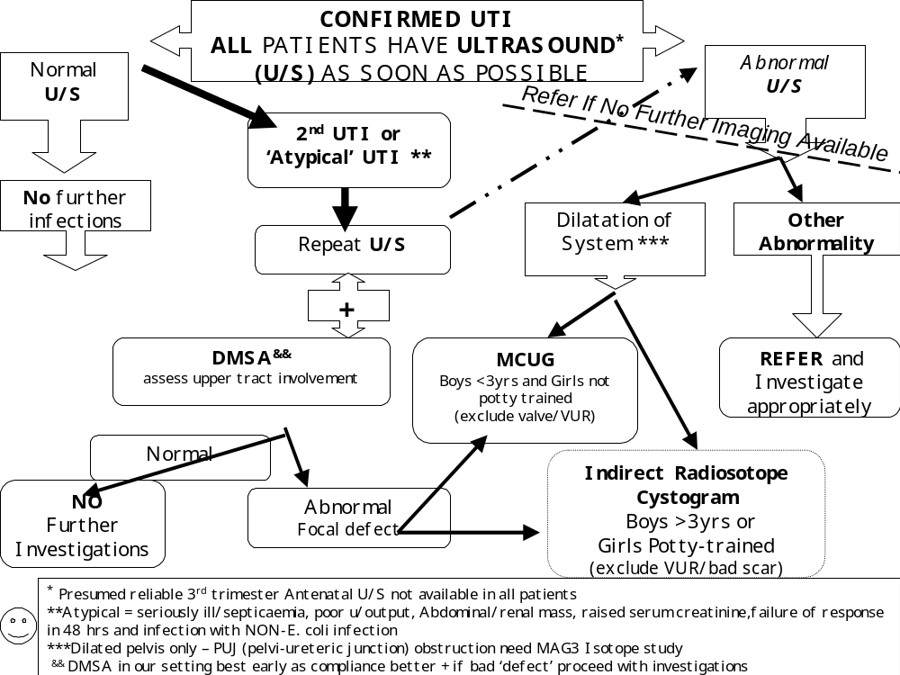

Slide 48
Scenario 1
6 year old girl Farida with dysuria no fever comes to casualty
Clinically well, normal BP
What would you do?
Ultrasound KUB as you would not be sure about antenatal ultrasound or previous infection
If normal just followup with repeat urine tests

Slide 49
Scenario 2
4 month old Ismail admitted with high fevers and urine growing klebsiella
What would you do?
Answer:
Ultrasound KUB
MCUG earliest convenient time
DMSA depending on what you see on ultrasound

Slide 50
Scenario 3
3 year old Waceke
3rd episode UTI with E coli
What would you do?
Answer:
Ultrasound KUB
DMSA scan to rule out scarring
+ - MCUG

Slide 51
Summary
Diagnosis of UTI: bag specimen only for screening use dipstick
Clean catch, in out catheter or suprapubic catheter and send for microscopy culture
Treat the UTI appropriately
Investigations only of true UTI based on culture unless confounders
In our setting start with ultrasound KUB
Refer these children early and appropriately

Slide 52
References
American Academy of Pediatrics: Practice Parameter: The Diagnosis, Treatment, and Evaluation of the Initial Urinary Tract Infection in Febrile Infants and Young Children. Pediatrics, 103(4 Pt 1): 843-52, 1999
Benadot D, Benador M, Slosman D et al. Are younger children at highest risk of renal sequelae after pyelonephritis? Lancet, 349(9044): 17-9, 1997
Craig J, Knight J, Sureshkumar P, et al. Effect of circumcision on incidence of urinary tract infection in preschool boys. J Pediatrics. 128(1): 23-7, 1996
Fitzgerald A, Lee CW, Mori R. Antibiotics for treating uncomplicated urinary tract infection in children. (Protocol) Cochrane Database of Systematic Reviews 2007, Issue 4 Art. No: CD006857. DOI:10.1002/14651858.CD006857
Goldman M, Lahat E, Strauss S et al. Imaging after Urinary Tract Infection in Male Neonates. Pediatrics, 105:1232-1235, 2000
Gordon, I; Barkovics, M; Pindoria, S. et al. Primary vesicoureteric reflux as a predictor of renal damage in children hospitalized with urinary tract infection: a systematic review and meta-analysis. J American Society of Nephrology, 14(3):739-44, 2003.
Gorelick, MH and Shaw KN. Screening tests for urinary tract infection in children: A meta-analysis. Pediatrics, 104(5):e45, 1999
Jodal U and Lindberg U. Guidelines for management of children with urinary tract infection and vesico-ureteric reflux: Recommendations from a Swedish state-of-the-art conference. Swedish Medical Research Council. Acta Pediatrica Suppl, 88(431): 87-9, 1999

Slide 53
References
Micahel M, Hodson EM, Craig JC et al. Short versus standard duration oral antibiotic therapy for acute urinary tract infection in children. Cochrane Databases of Systematic Reviews 2003. Issue 1. Art. No.,:003966.DOI:10.1002/14651858.CD003966
National Collaborating Centre for Women’s and Children’s Health: Urinary tract infection in children: diagnosis, treatment and long-term management. National Institute for Health and Clinical Excellence (NICE), 2007
Pohl A. Modes of administration of antibiotics for symptomatic severe urinary tract infections (Review). Cochrane Database of Systematic Reviews. 2007, Issue Art . No., CD003237. DOI: 10.1002/1461858. CD003237. pub2
Saux N, Pham B, and Moher D. Evaluating the benefits of antimicrobial prophylaxis to prevent urinary tract infections in children: A systematic review. Canadian Medical Association Journal. 163(5): 523-529, 2000.
Syed M. Ahmed, and Steven K. Swedlund. Evaluation and Treatment of Urinary Tract infections in children. Am Family Physician, 57(7): 1573-80, 1583-52, 1998
UTI Guideline Team, Cincinnati Children’s Hospital Medical Center: Evidence-based care guideline for medical management of first urinary tract infection in children 12 years or less, Guideline 7 (1-23), 2006
UptoDate 15. 3, 2007
Williams, G; Lee, A; Craig, J et al. Antibiotics for the prevention of urinary tract infection in children: A systematic review of randomized, controlled trials. J Pediatrics, 138(6)/868-874, 2001.

Slide 54
Diagnosis
Any child with features of UTI needs to be seen by doctor within 24 hrs of symptoms as complications increase thereafter
Urine test will be done
Collection methods
  In older children:
    Clean catch
  In younger children
    Urine bag only for screening
    Urethral catheterisation
    Suprapubic catheterisation

Slide 55

Urine bag

Slide 56

Urethral catheterisation

Slide 57

Suprapubic sampling

Slide 58
Treatment
Any child diagnosed with UTI will need to be on antibiotics for atleast 7 days
Children who need admission for parenteral antibiotics:
  Children less than 2 months
  Very high fevers and toxic looking
  Severe flank and abdominal pains
  Severe vomiting

Slide 59
Other investigations
Very important in children because
  You need to rule out congenital problems leading to predisposition to UTI
  You need to pick out children who are at risk of developing kidney scarring and long term complications

Slide 60
Why investigate??
There is a 10- 15% risk of developing kidney scarring after UTI
The risk increases with every subsequent UTI
The risk of developing hypertension in a person with renal scarring is about 25%
The risk of developing end stage renal disease about 10%

Slide 61
Who should be investigated??
Any child with urine tract infection under the age of 2 years
A boy of any age with a urine tract infection
A child with a febrile UTI
Any child with more than one urine tract infection

Slide 62
What investigations
Ultrasound:
  Non invasive
  Kidney size and shape
  Presence of obvious obstruction
  Bladder capacity
  User dependant
  Little information on reflux

Slide 63
Investigations
Micturating cystourethrogram (MCUG)
  Information on vesicoureteric reflux
  Posterior urethral valves
  Bladder function

Slide 64
NUCLEAR STUDIES
DMSA scan:
  Picks up pyelonephritis
  Scarring, may need to be repeated
  Kidney function

